Slide 1

Indian Sign Language Interpretation Integrating Pose Detection and Speech Synthesis
Presented by -
Abhishek Lal (C23039)
Anubhab Koley(C23006)
Sayan Ghosh Roy(C23026)
Shivam(C23028)

Slide 2

Content
Introduction
Indian Sign Language (ISL)
Objective
DATASET & DATA PREPARATION
MODEL & TRAINING
APPLICATION INTERFACE
FUTURE SCOPE
Impact Areas As per importance
WORKFLOW
DATA SOURCE

Slide 3

Introduction
Hearing loss is the most common sensory deficit in humans today. As per WHO estimates in India, there are approximately 63 million people, who are suffering from Significant Auditory Impairment; this places the estimated prevalence at 6.3% in Indian population. As these speech impairments and deaf people need a proper channel to communicate with normal people there is a need for a system. Not all normal people can understand the sign language of impaired people. Our project hence is aimed at converting the sign language gestures into text that is readable for normal people.

Slide 4
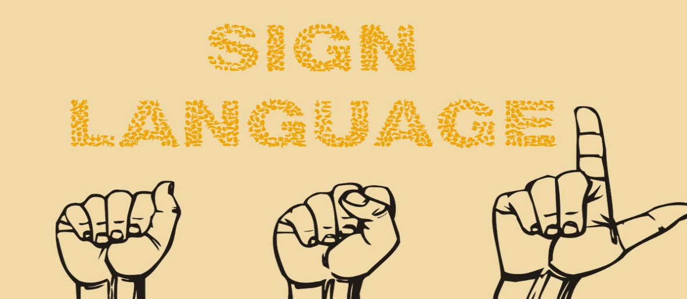
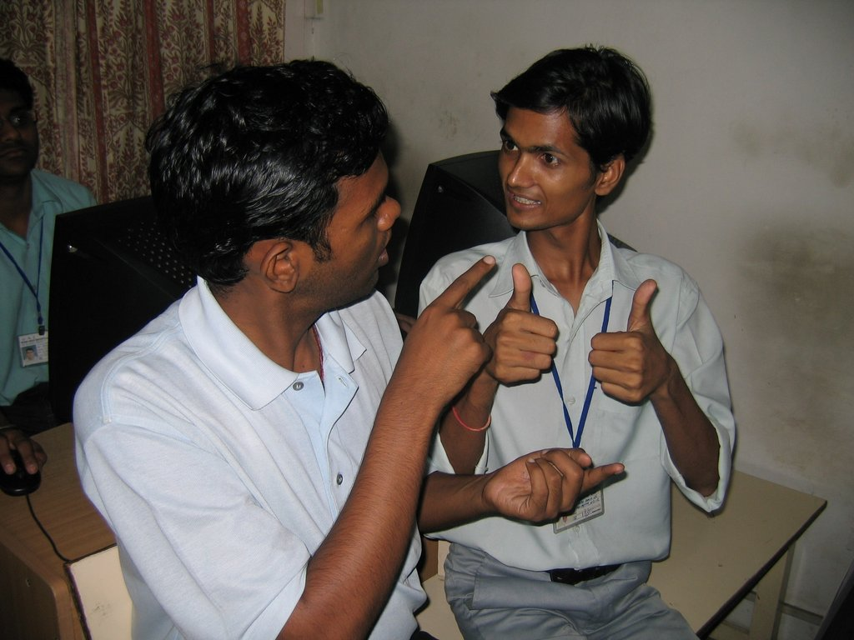
Indian Sign Language (ISL)
Importance of ISL
ISL and Education
ISL plays a crucial role in facilitating communication and social interaction among the deaf community in India.
It is estimated that there are over 63 million deaf people in India, and ISL provides them with a means to communicate with each other and with the hearing world.
ISL is also important in education for deaf children, as it allows them to access information and participate in classroom discussions.
Many schools for the deaf in India use ISL as the primary mode of instruction, and there is a growing movement to recognize ISL as an official language in India.

Slide 5
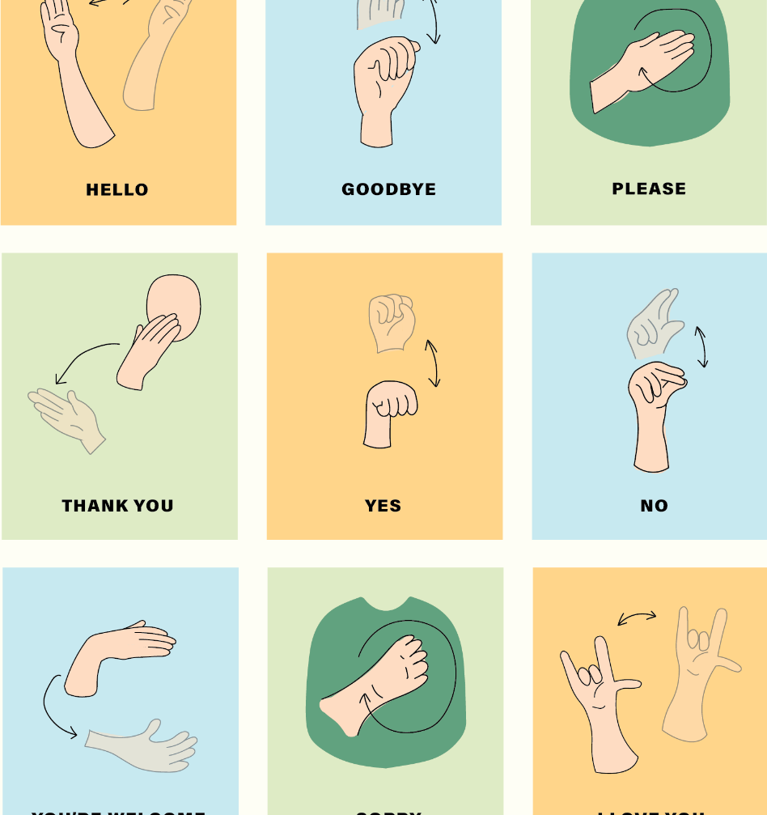
Objective
Indian Sign Language(ISL) is a visual language used by the deaf and dumb community in India to communicate with each other and with hearing individuals.
The objectives of project include:
Reducing communication gap between physically challenged people and other normal people.
Through neural network implementation that helps recognition of hand signs.
Converting this hand sign into text to speech synthesis.

Slide 6
WORKFLOW
DATA AQUISITION
MODEL TRAINING & VALIDATION
DEPLOYMENT
APPLICATION INTERFACE
DATA PREPARATION

Slide 7

DATA SOURCE
Indian Sign Language Research and Training Centre visions –
To build an inclusive society in which equal opportunities are provided for the growth and development of Persons with Disabilities so that they can lead productive, safe and dignified lives.

Slide 8
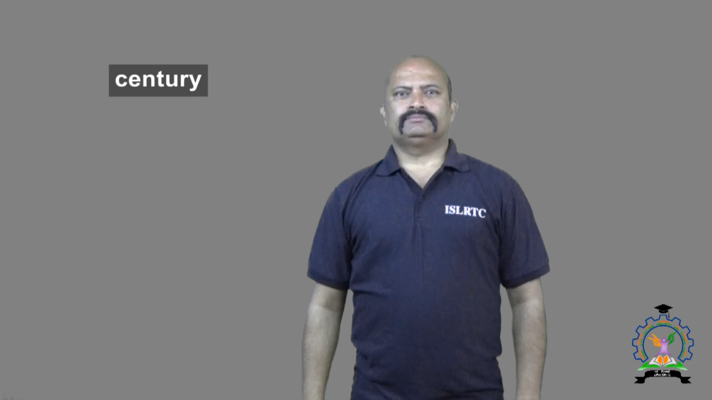
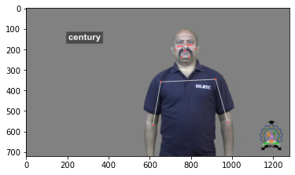
DATASET & DATA PREPARATION
Video Dataset is used for the Project
CV2 and Mediapipe has been used to detect the gestures shown
Mediapipe draws landmarks on the subject which tracks the different gestures while describing a word

Slide 9
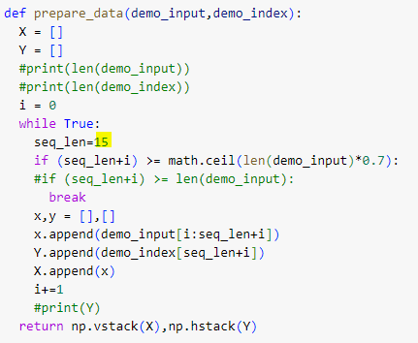
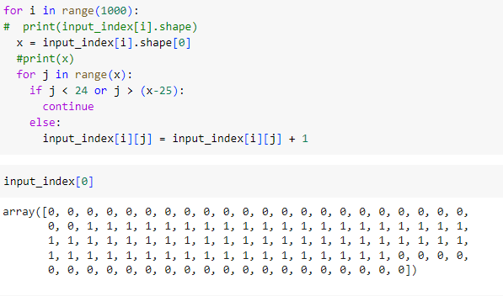
Sequential data has been created with a window of 15 frames
Target has been created taking the indexes of the video stored.
First and last 24 indexes are made 0 to handle the part where the person is not doing any gesture

Slide 10
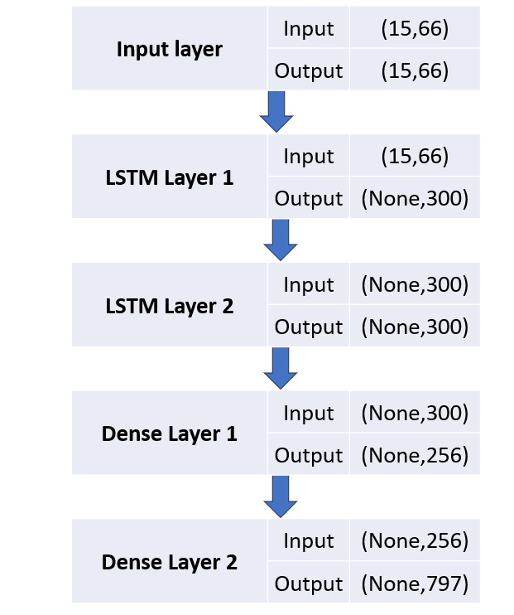
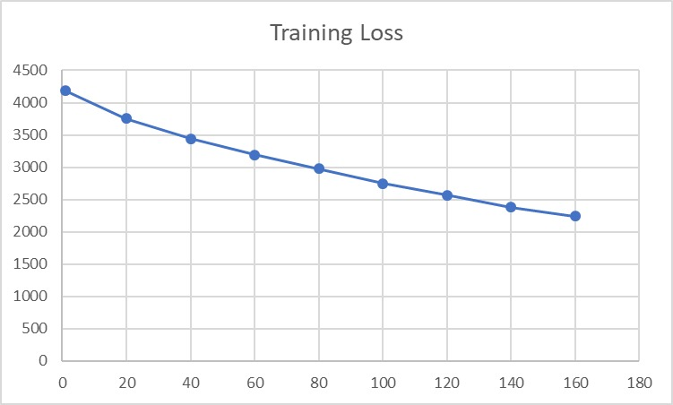
MODEL & TRAINING
LSTM Model has been used for Training
Training loss per epochs

Slide 11
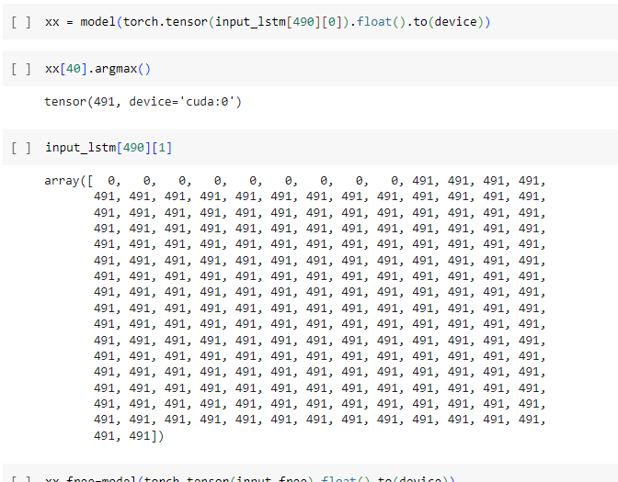
RESULTS
Results show that while predicting a data by the model the prediction and the actual index predictions are same

Slide 12
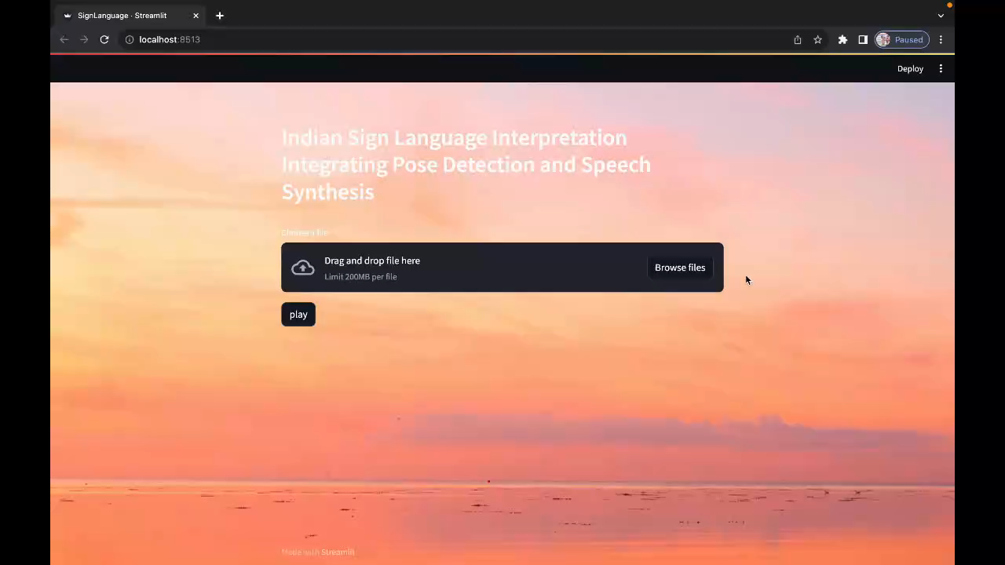
APPLICATION INTERFACE

Slide 13
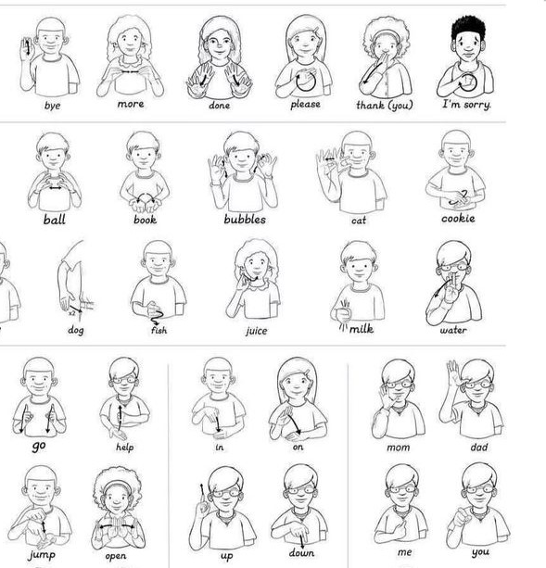
Impact Areas As per importance
Enhanced Communication for the Deaf and Hard of Hearing:
Impact: Deaf and hard of hearing individuals can communicate more effectively with the hearing population, reducing isolation and fostering social integration.
Accessibility:
Impact: Improved accessibility allows Deaf individuals to access digital content, services, and public spaces, enhancing their overall quality of life.
Education:
Impact: Access to educational content in sign language improves the academic performance and educational experience of Deaf students.
Job Opportunities:
Impact: AI facilitates access to a broader range of employment opportunities, reducing economic disparities among Deaf and hard of hearing individuals.

Slide 14

FUTURE SCOPE
The models can be made more robust and better if it gets trained over variations of video for the same word.
This objective can be extended to predict a sentence.
This model can be further scaled up to detect the subject and identify their gestures even in complex background.

Slide 15


